Slide 1
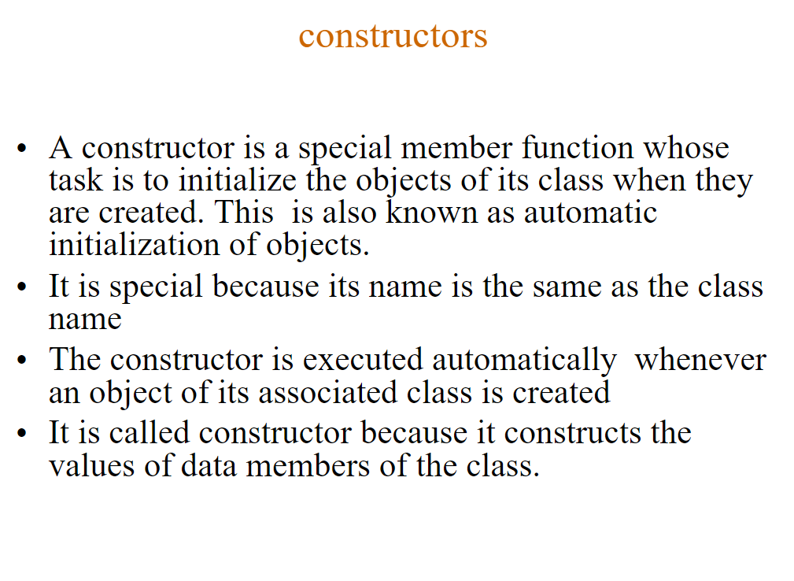

Slide 2
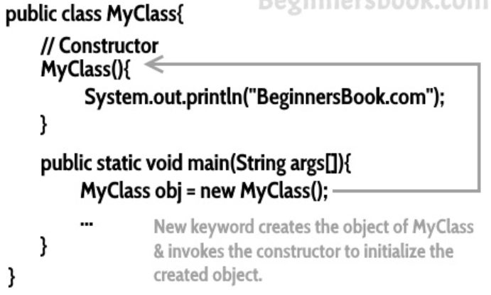

Slide 3
How Constructors are Different From Methods in Java?
Constructors must have the same name as the class within which it is defined while it is not necessary for the method in Java.
Constructors do not return any type while method(s) have the return type or void if does not return any value.
Constructors are called only once at the time of Object creation while method(s) can be called any number of times.

Slide 4
public class Hello {
String name;
//Constructor
Hello(){
this.name = “Java";
}
public static void main(String[] args) {
Hello obj = new Hello();
System.out.println(obj.name);
}
}

Slide 5
import java.io.*;
class Stud {
int num;
String name;
// this would be invoked while an object
// of that class is created.
Stud() { System.out.println("Constructor called"); }
}
class Example {
public static void main(String[] args)
{
// this would invoke default constructor.
Stud stud1 = new Stud();
// Default constructor provides the default
// values to the object like 0, null System.out.println(stud1.name); System.out.println(stud1.num);
}
}

Slide 6
Output
Constructor called
null
0

Slide 7
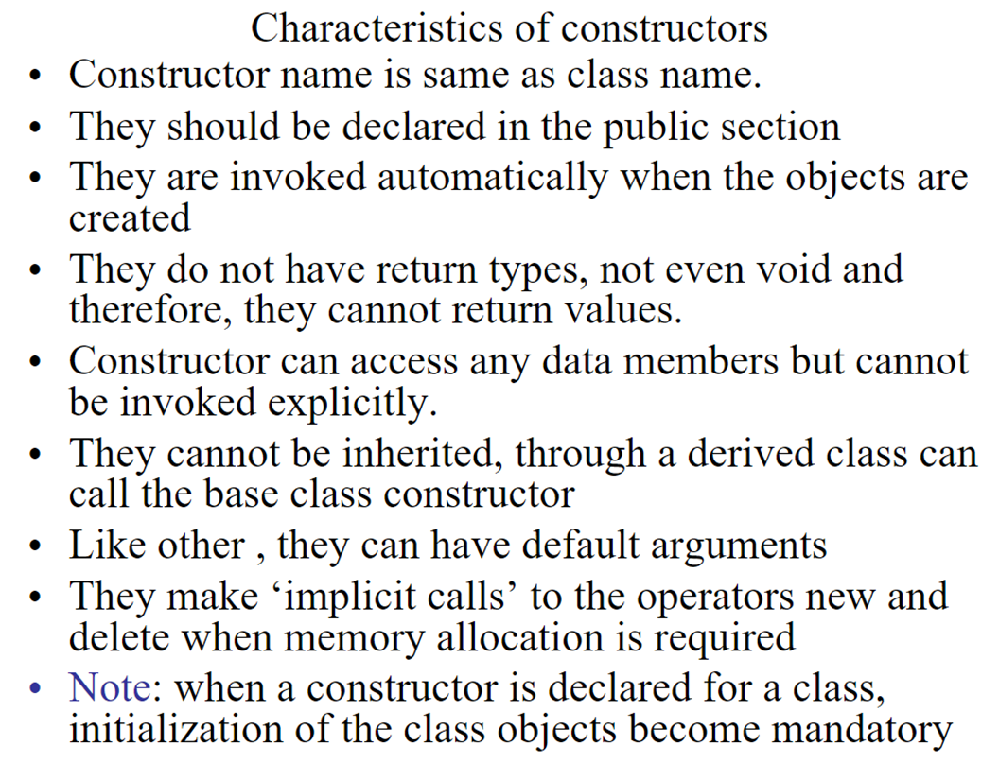

Slide 8
The rules for writing constructors are as follows:
Constructor(s) of a class must have the same name as the class
name in which it resides.
A constructor in Java can not be abstract, final, static, or Synchronized.
Access modifiers can be used in constructor declaration to control its
access i.e which other class can call the constructor.

Slide 9

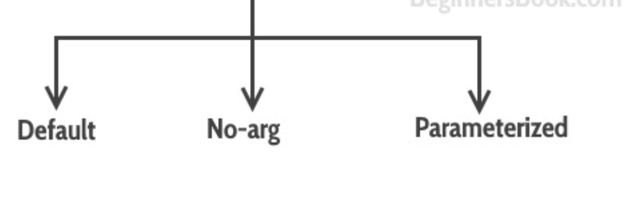
Types of Constructors

Slide 10
Default Constructor
If you do not implement any constructor in your class, Java compiler inserts a default constructor into your code on your behalf.
This constructor is known as default constructor.
You would not find it in your source code(the java file) as it would be inserted into the code during compilation and exists in .class file.

Slide 11
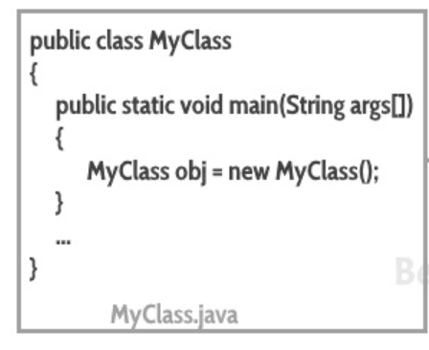
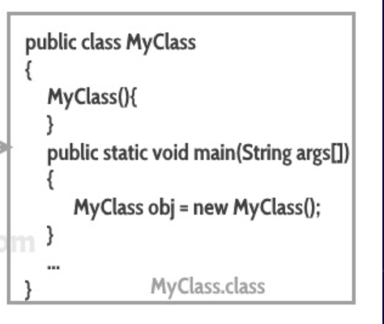
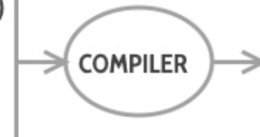

Slide 12
no-arg constructor:
Constructor with no arguments is known as no-arg constructor.
The signature is same as default constructor, we can have any code unlike default constructor where the body of the constructor is empty.

Slide 13
Example: no-arg constructor
class Demo
{
public Demo()
{
System.out.println("This is a no argument constructor");
}
public static void main(String args[]) {
new Demo();
}
}
Output:
This is a no argument constructor

Slide 14
Parameterized constructor
Constructor with arguments(or you can say parameters) is known as Parameterized constructor.

Slide 15
Example: parameterized constructor
public class Employee {
int empId;
String empName;
//parameterized constructor with two parameters
Employee(int id, String name){
this.empId = id;
this.empName = name;
}
void info(){
System.out.println("Id: "+empId+" Name: "+empName);
}
public static void main(String args[]){
Employee obj1 = new Employee(10245,"Chaitanya");
Employee obj2 = new Employee(92232,"Negan");
obj1.info();
obj2.info();
}
}

Slide 16
Output
Id: 10245 Name: Chaitanya
Id: 92232 Name: Negan

Slide 17
Example2: parameterized constructor
class Example2
{
private int var;
//default constructor
public Example2()
{
this.var = 10;
}
//parameterized constructor
public Example2(int num)
{
this.var = num;
}
public int getValue()
{
return var;
}

Slide 18
Continue…
public static void main(String args[])
{
Example2 obj = new Example2();
Example2 obj2 = new Example2(100);
System.out.println("var is: "+obj.getValue());
System.out.println("var is: "+obj2.getValue());
}
}
Output:
var is: 10
var is: 100

Slide 19
What if you implement only parameterized constructor in class
class Example3
{
private int var;
public Example3(int num)
{
var=num;
}
public int getValue()
{
return var;
}
public static void main(String args[])
{
Example3 myobj = new Example3();
System.out.println("value of var is: "+myobj.getValue());
}
}

Slide 20
Output: It will throw a compilation error. The reason is, the statement Example3 myobj = new Example3() is invoking a default constructor which we don’t have in our program. when you don’t implement any constructor in your class, compiler inserts the default constructor into your code, however when you implement any constructor (in above example I have implemented parameterized constructor with int parameter), then you don’t receive the default constructor by compiler into your code.
If we remove the parameterized constructor from the above code then the program would run fine, because then compiler would insert the default constructor into your code.

Slide 21
Difference between Constructor and Method
The purpose of constructor is to initialize the object of a class while the purpose of a method is to perform a task by executing java code.
Constructors cannot be abstract, final, static and synchronised while methods can be.
Constructors do not have return types while methods do.

Slide 22
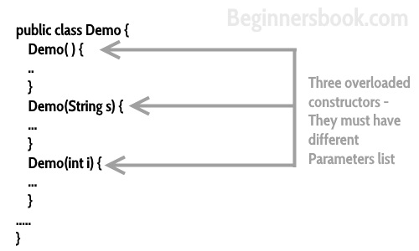
Constructor Overloading
Constructor overloading is a concept of having more than one constructor with different parameters list, in such a way so that each constructor performs a different task.

Slide 23
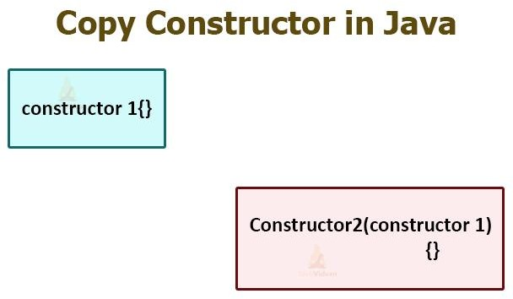
Copy Constructor
A Copy Constructor in Java is a special type of constructor that is used to create a new object using the existing object of a class that we have created previously.
It creates a new object by initializing the object with the
instance of the same class.

Slide 24
It is used if we want to create a deep copy of an existing object.
It is easier to implement in comparison to the clone() method.
Advantages of Copy Constructor
If a field declared as final, the copy constructor can change it.
There is no need for typecasting.
Its use is easier if an object has several fields.
Addition of field to the class is easy because of it. We need to change only in the copy constructor.

Slide 25
Copy Constructor Vs clone() Method
Both the copy constructor and the clone() method are used to create a copy of an existing object of the class. But the use of copy constructor is easier and better in comparison to the clone()
If we are using the clone() method it is necessary to import the Cloneable The method may throw the exception CloneNotSupportException. So, handling the exception in a program is a complex task. While in copy constructor there are no such complexities.
We cannot assign a value if the fields are final. While in the copy constructor we can assign values to the final fields.
The object returned by the clone() method must be typecast. While in copy constructor there is no such requirement.

Slide 26
Java Copy Constructor
class JavaExample{
String web;
JavaExample(String w){
web = w;
}
/* This is the Copy Constructor, it
* copies the values of one object
* to the another object (the object
* that invokes this constructor)
*/
JavaExample(JavaExample je){
web = je.web;
}
void disp(){
System.out.println("Website: "+web);
}

Slide 27
Destructor
The destructor is the opposite of the constructor.
The constructor is used to initialize objects while the destructor is used to delete or destroy the object that releases the resource occupied by the object.
A destructor is a special method that gets called automatically as soon as the life-cycle of an object is finished.
A destructor is called to de-allocate and free memory.
The following tasks get executed when a destructor is called.
Destructors in Java also known as finalizers are non- deterministic

Slide 28
Destructor
there is no concept of destructor in Java.
The garbage collector is a program (thread) that runs on
the JVM. It automatically deletes the unused objects (objects that are no longer used) and free-up the memory.
When an object completes its life-cycle the garbage collector deletes that object and deallocates or releases the memory occupied by the object.

Slide 29
Destructor
It is also known as finalizers that are non-deterministic. In Java, the allocation and deallocation of objects handled by the garbage collector. The invocation of finalizers is not guaranteed because it invokes implicitly.
Advantages of Destructor
It releases the resources occupied by the object.
No explicit call is required, it is automatically invoked at the
end of the program execution.
It does not accept any parameter and cannot be overloaded.

Slide 30
Java finalize() Method
Syntax:
protected void finalize throws Throwable()
{
//resources to be close
}
System.runFinalizersOnExit(true).
It is a protected method of the Object class that is defined in the java.lang package.
It can be called only once.
We need to call the finalize() method explicitly if we want to override the method.
The gc() is a method of JVM executed by the Garbage Collector. It invokes when the heap memory is full and requires more memory for new arriving objects.

Slide 31
Example of Destructor
DestructorExample.java public class DestructorExample
{
public static void main(String[] args)
{
DestructorExample de = new DestructorExample (); de.finalize();
de = null;
System.gc();
System.out.println("Inside the main() method");
}
protected void finalize()
{
System.out.println("Object is destroyed by the Garbage Collector");
}
}

Slide 32
Difference Between Constructor and Destructor
Constructor | Destructor
It helps allocate memory to an object. It can take arguments. It is called automatically when an object is created. It allows an object to initialize a value before it is used. They are called in the successive order of their creation. There can be multiple constructors in a single class. The copy constructor allows the constructor to declare and initialize an object from another object. It can be overloaded. | It deallocates the memory of an object. It doesn’t take any argument. It is called automatically when the block is exited or when the program terminates. They allow objects to execute code when it is being destroyed. They are called in the reverse order of their creation. There is a single destructor in a class. Destructor can’t be overloaded.
32

